Slide 1

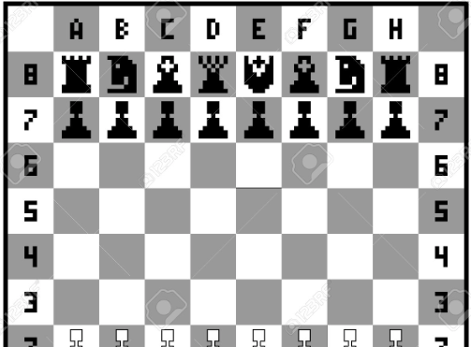
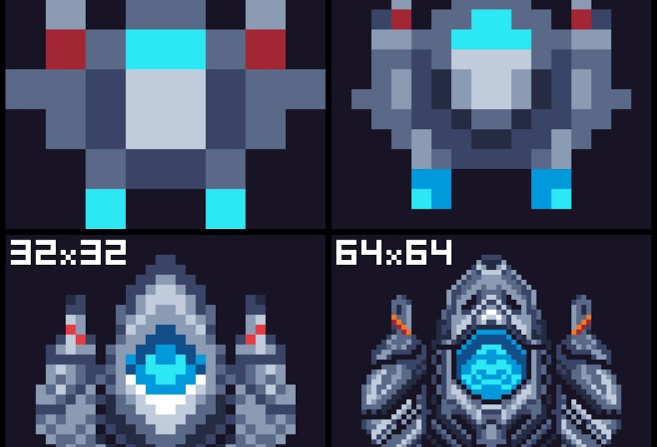



Home Décor Embedded Systems 2025
FOLLOW - UP
Sage Marks and Matt Krueger

Slide 2
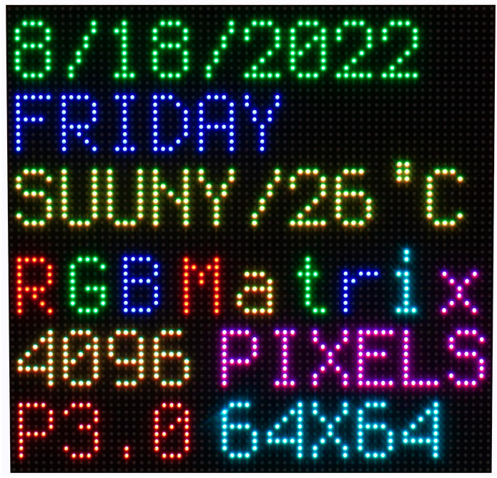
Issues: Address Space of Uno
Problem: memory size of ATmega328p
ATmega328P has 2KB SRAM whilst there are 4096 addresses on the LED matrix (64^2). Ultimately, the ATmega328p is NOT COMPATIBLE with any 64x64 led matrix due to its limited address space.
Solution: use adequate microcontroller
An easy alternative (and a microcontroller that we have on hand already) is the ESP32. The ESP-Wroom-32 has 512MB of RAM, which can access the 4096 led addresses in the matrix… and more.

Slide 3
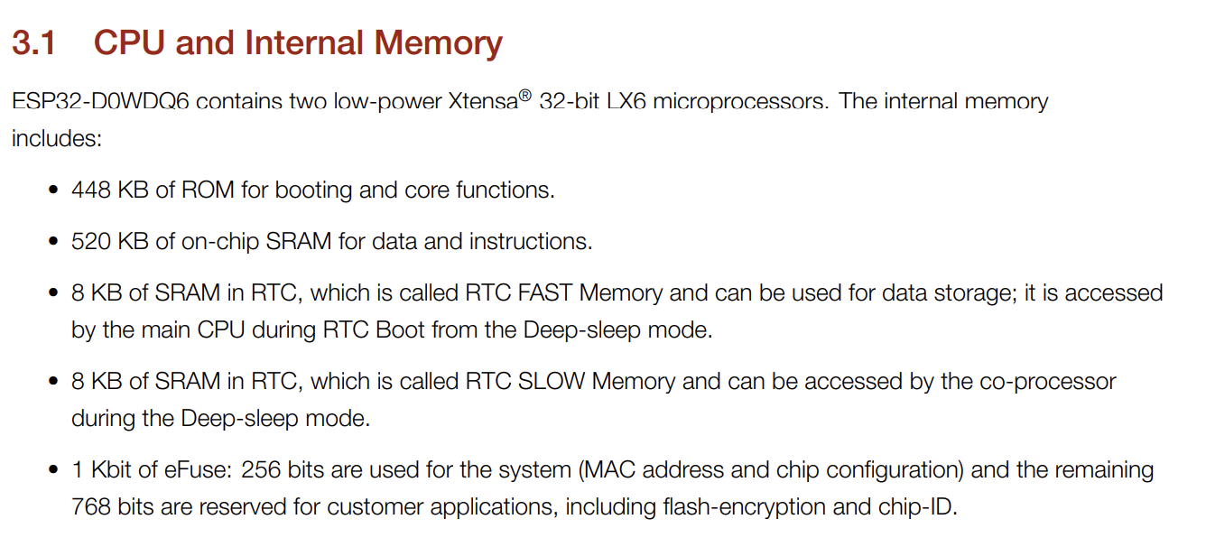

ESP-32 Specs:
Datasheet: ESP-WROOM-32
Blog featuring esp32 to 64x64 lcd : Waveshare

Slide 4
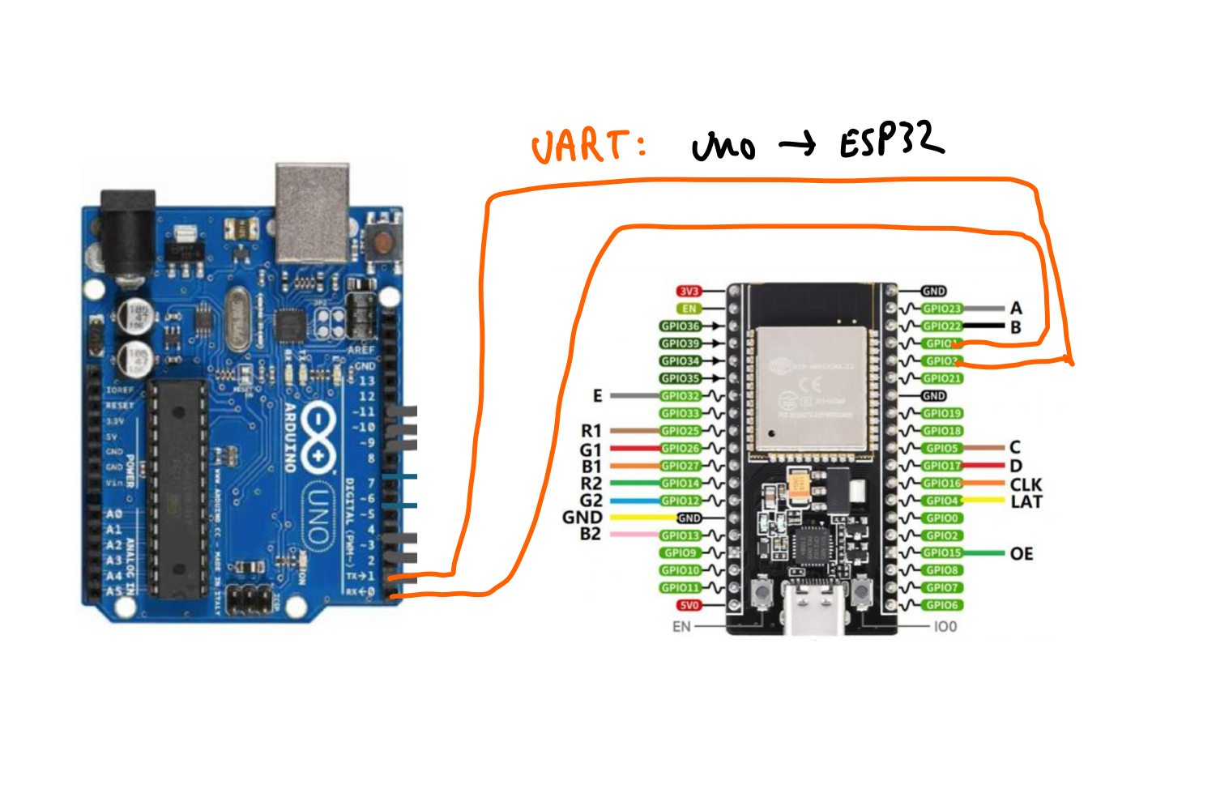
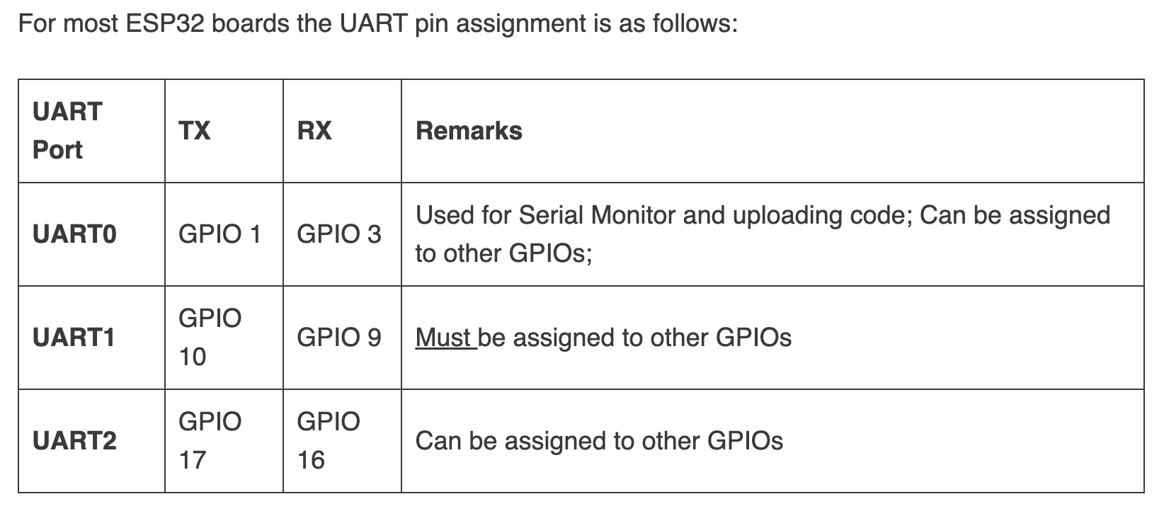
Compromise
UART pins would be open after connecting ESP32 to the LED matrix, which we could connect to our Arduino with other sensors.
Separate programs would be written:
Arduino + peripheral device data capture
ESP32 + LED interface
As a compromise, we could use ESP32 solely for interfacing the LED and not utilize any of its Bluetooth/Wifi capabilities. It would serve as a middleman for the Arduino and the LED

Slide 5
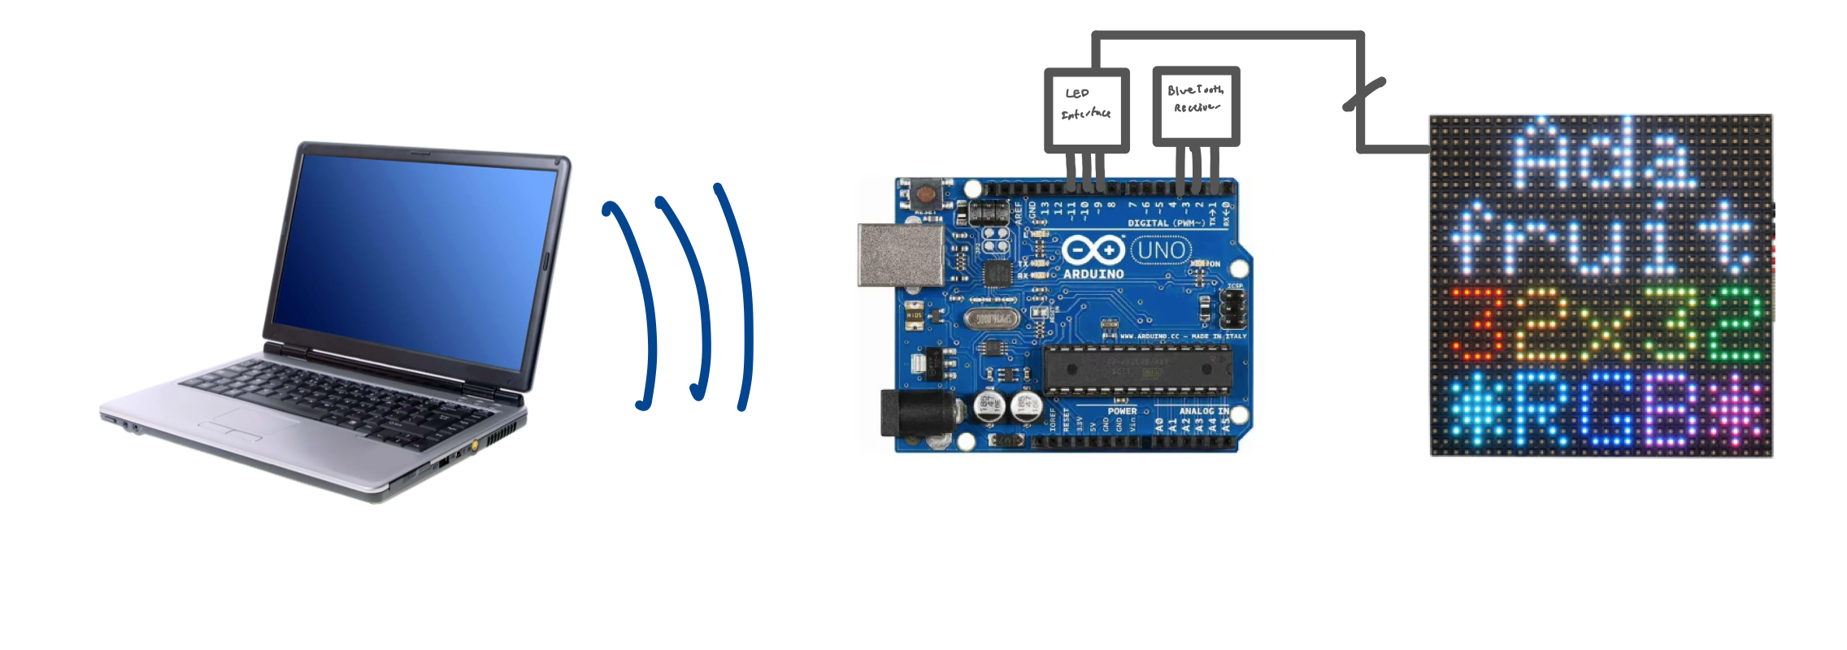
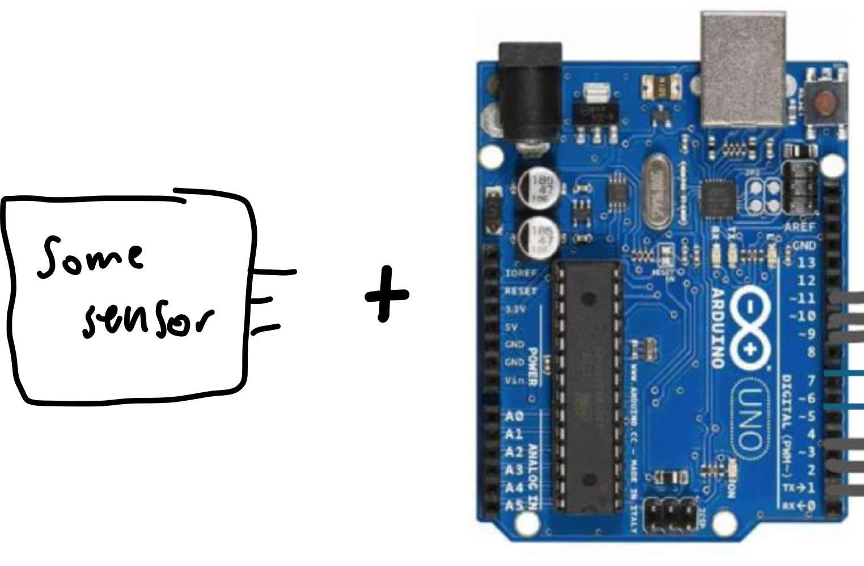
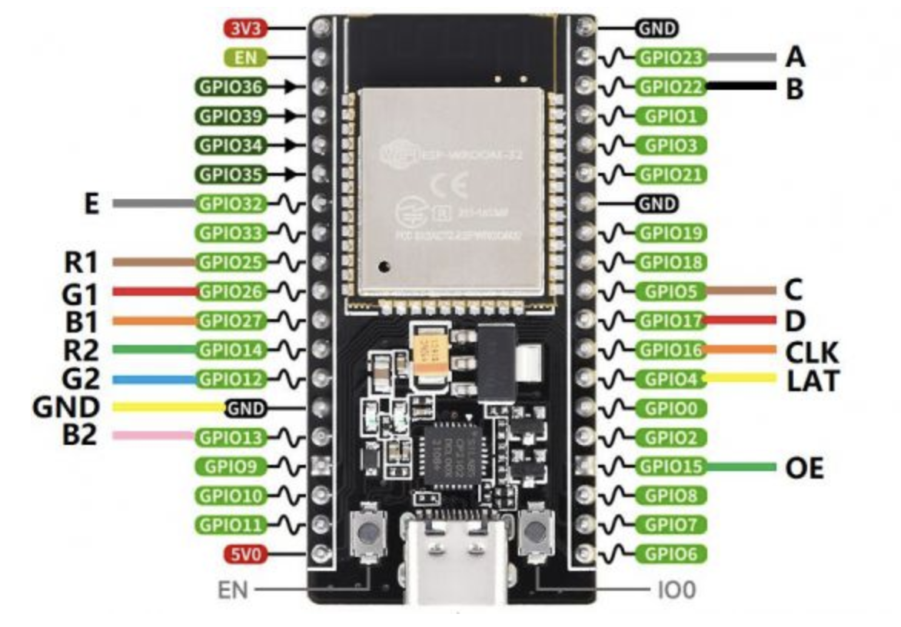

High Level Workflow
2) Communication
UART seems feasible
ESP32 analysis and LED Interface
Interpret signal to drive LED
- Compute LED row/col and RGB
Send to LED Matrix
Peripheral Sensors and Arduino analysis
- Capture data to send to LED driver (esp)
1) Data Capture
3) Display
2) Display

Slide 6
Required Components
Component | Amount Required | Usage | Do we have?
ESP32 | 1 | LED Matrix Interface | YES
64x64 LED Matrix | 1 | Display sensor data | YES
Arduino UNO | 1 | Capture sensor data | YES
Sensor | TBD | TBD | TBD

